Slide 1
Unit 11
How was your school trip?
Section B 1a-1e
七年级下册

Slide 2

Objectives
To learn more trip phrases: go to the zoo, visit a museum, ride a horse, climb a mountain, visit a fire station, go fishing
To listen and learn Jane’s and Tony’s school trip

Slide 3
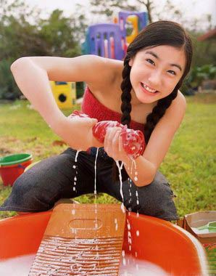
What did she do yesterday?
did some washing
She ________________ yesterday.

Slide 4
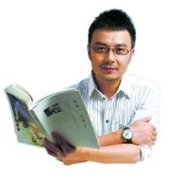
What did Wang Han do last night?
He ___________ last night.
read a book

Slide 5
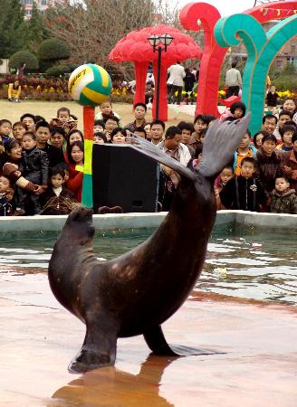
What did they do on the school trip?
They _________________ on the school trip.
watched a seal show

Slide 6
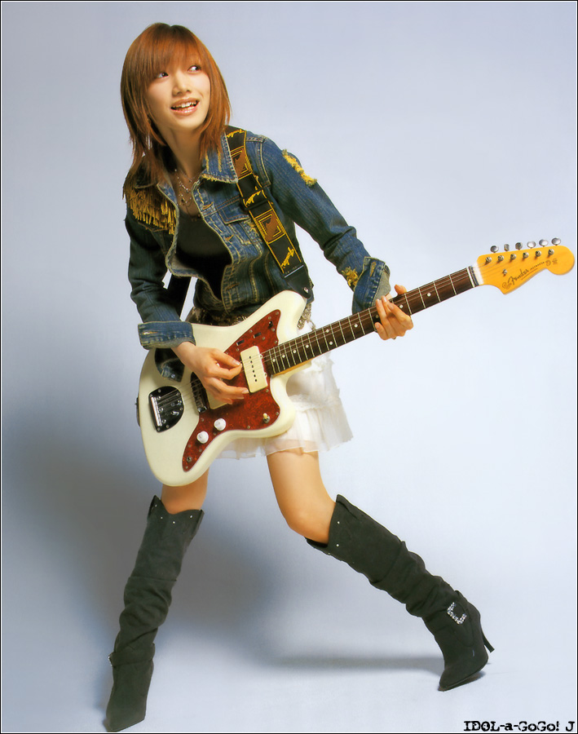
What did she do on her day off ?
played the guitar
She _______________ on her day off.

Slide 7
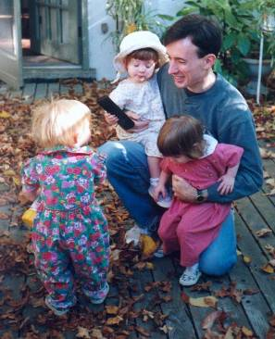
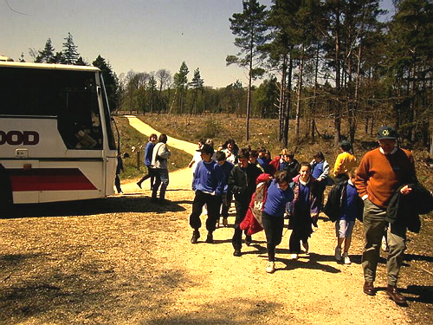
On last day off
On that day, he didn’t want to babysit his cousins. It was really boring.
He had a school trip.
It was pretty good.
He liked it.

Slide 8
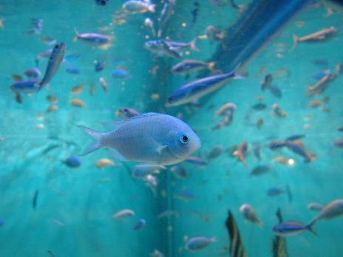
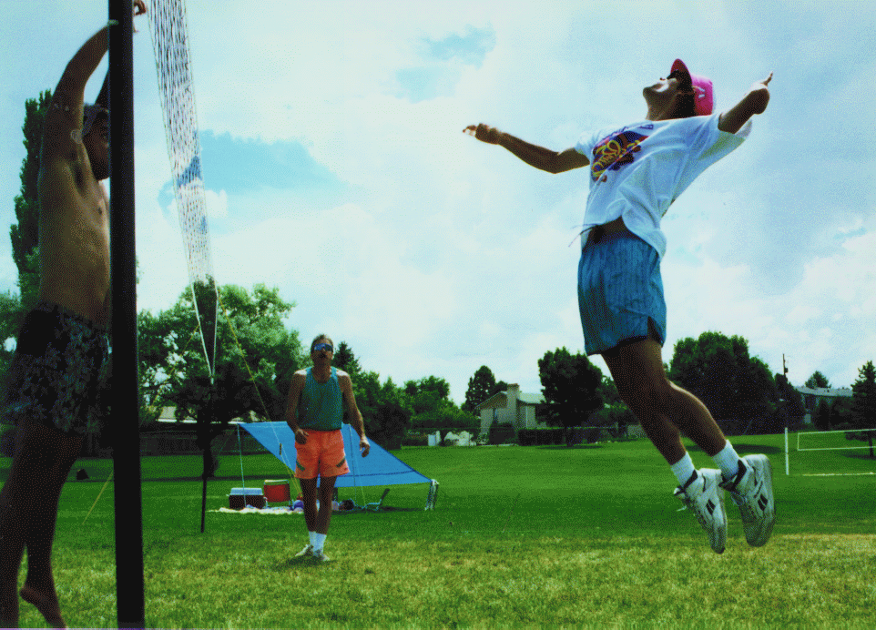
On last day off
On that day, she didn’t
want to play volleyball.
It was boring.
She went to the aquarium.
It was interesting.

Slide 9
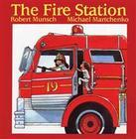
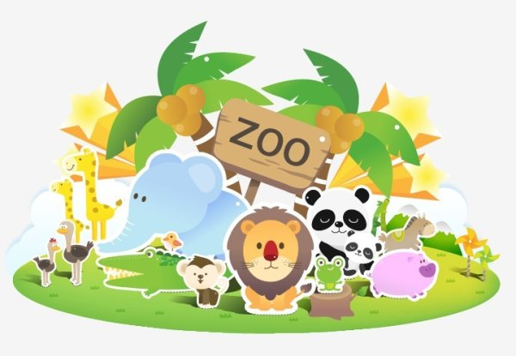
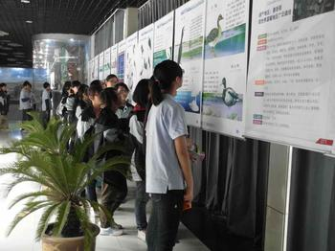
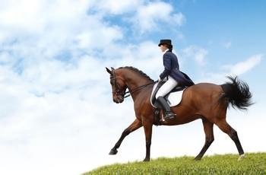
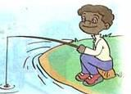
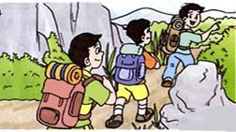
Make up a story. Each student adds a sentence. If he or she can’t add a sentence, he or she must sing an English song.

Slide 10
Last week, I went to the zoo.
I __________ in the zoo. After that I ___________. I ___________________.
__________________.
1 go to the zoo 2 visit a museum
3 ride a horse 4 climb a mountain
5 visit a fire station 6 go fishing

Slide 11
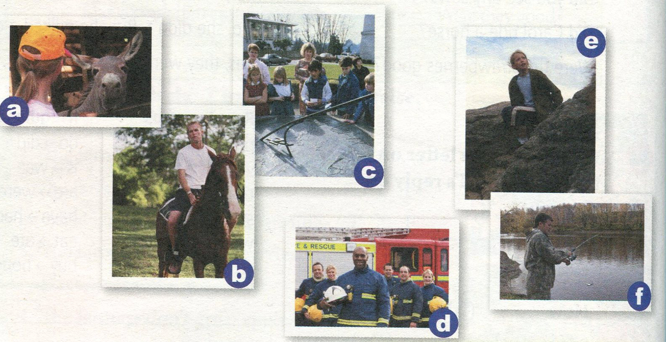
1a. Match the activities with the pictures.
a
e
1. go to the zoo____
2. visit a museum____
3. ride a house______
4. climb a mountain____
5. visit a fire station____
6. go fishing_______
c
d
b
f

Slide 12


1b. Listen and answer the
questions.
1. How was Jane’s trip ?
_____________________
2. How was Tony’s trip?
_____________________
It was terrible.
It was great.

Slide 13
1c. Listen again. What did Jane and
Tony do on their last school trip?
Check(√) Tony or Jane.
 | Went to the countryside | Climbed a mountain | Went to an art museum | saw some painting | drew pictures
Tony
Jane
√
√
√
√
√

Slide 14
Pairwork
1d What was your last school trip like?
Discuss it with your partner.
I went to...
That sounds...

Slide 15
A: I went to a farm on my last school trip.
There were many animals on the farm.
They were very lovely.
B: That sounds great.
A: How was your school trip?
B: It was __________
A: How was the food there?
B: It was _____________
A: How was the weather?
B: It was ___________

Slide 16
一、词汇
Exercises
souvenir
1. Last Sunday I brought a ________(纪念
品) from Japan.
2. We saw many fish and sharks in the
____________(水族馆).
3. The students _______(have) a school trip
yesterday.
4. Where _______ (be) he last night?
5. They ________(visit) Chicago last year.
aquarium
had
was
visited

Slide 17
二 翻译下列短语和句子。
1. 到达那儿
2. 下棋
弹钢琴
打篮球
3. 对感兴趣
4. 总之
get there
play chess
play the piano
play basketball
be interested in
all in all

Slide 18
not …at all
today’s newspaper
too many students
too much water
It is easy for me to learn English.
Last week Mr. Li taught me how to play chess.
5. 根本不
6. 今天的报纸
7. 太多学生
太多水
8. 学英语对我来说很容易。
9. 上周李老师教我如何下棋。

Slide 19
三、根据提示完成句子
camping
1. Did the children have fun ________ (camp)?
2. The weather _____ (be) terrible yesterday.
3. Eric doesn’t want ________ (watch) TV with his grandmother.
was
to watch

Slide 20
came
4. No one _____ (come) to the concert
because of the bad weather.
5. Last Tuesday Miss Cooler _______
_____ (not take) a class.
6. How was your ________ (休息日),
Da Ming?
didn’t
take
day off

Slide 21
played computer games
7. I _____________________ (玩电脑
游戏) with my brother yesterday
afternoon.
8. It rained _______ (整天).
9. Bill wants to be an actor ___________.
(将来)
all day
in the future

Slide 22
四、单项选择
1. Were there _____ sharks?
A. some B. any C. a lot
2. What _______ did you do?
A. other B. else C. others
3. —Were you at home yesterday?
— ________.
A. Yes, I were B. Yes, I am. C. Yes, I was.
B
B
C

Slide 23
4. — Did they take any photos?
—________.
A. No, they didn't B. No, they did
C. No, they aren't
5. My mother _______ some cakes for
us last night.
A. makes B. maked C. made
A
C

Slide 24
B
5. I asked her for ____ orange juice, but she didn’t have ____.
A. any, any B. some, any
C. some, some D. any, some
6.—Would you like to drink ______?
—Yes, I’ d like a cup of coffee.
A. something else B. else something
C. anything else D. else anything
A

Slide 25
Homework
假如你上周去了动物园，以“My Unforgettable School Trip”为题,
写一篇短文。

Slide 26
Thank You!

